Slide 1
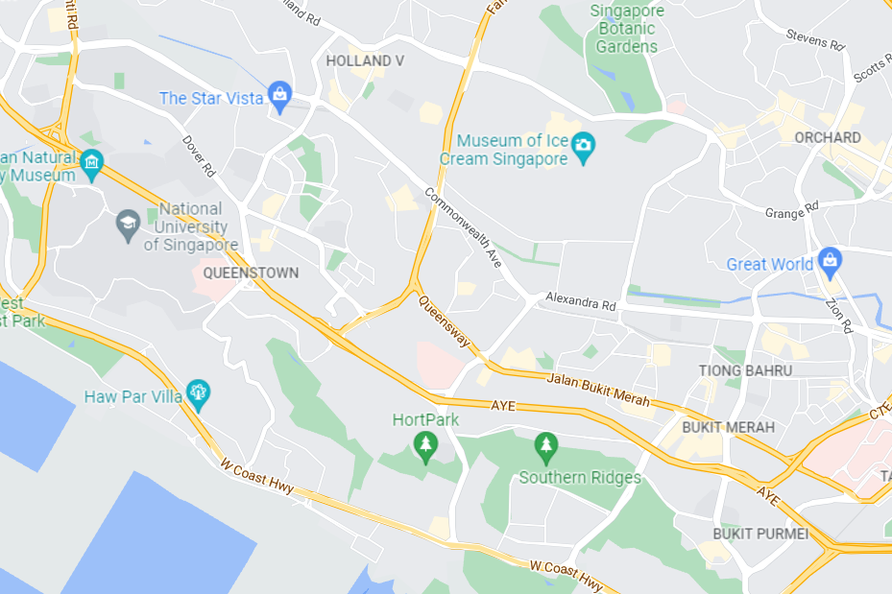

Search for food |

Slide 2
WhaToEat
Search for food |
Filters
Food Type
Spiciness
Soup or Dry
Hot or Cold

Slide 3
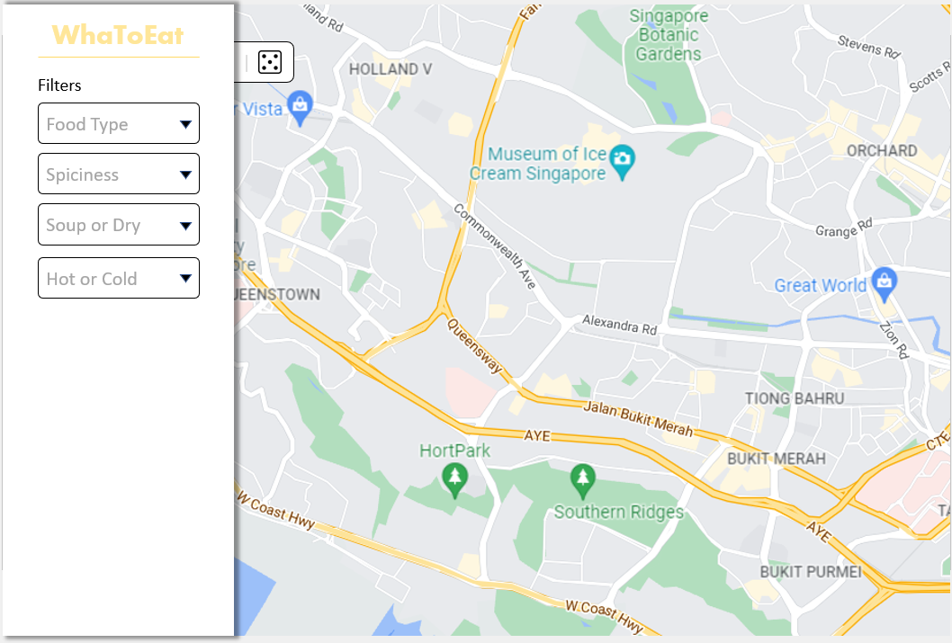
Client-side

Slide 4
WhaToEat
Filters
Food Type
Spiciness
Soup or Dry
Hot or Cold

Slide 5
WhaToEat

